Slide 1
Experiment - 1
BPSK Modulation and demodulation
Ritu Ann Roy George
B170106ec
S7 ece b batch

Slide 2
AIM
To simulate a digital communication system in the presence of noise that uses coherent BPSK with antipodal signalling and plot BER curves (Eb/No in dB vs. probability of bit error on a log scale) and to compare the error performance by
Plotting the original constellation diagram for the transmitted symbols assuming no noise. (Generate a random sequence of about 1024 BPSK symbols per frame.)
Adding AWGN with different variance values and plot the constellation diagram.
Applying coherent detection and compute BER for Eb/No in [0; 14] dB in steps of 2dB
Plotting BER versus Eb/No. Verify BER plot (simulations) with an analytical computation of BER for BPSK.

Slide 3
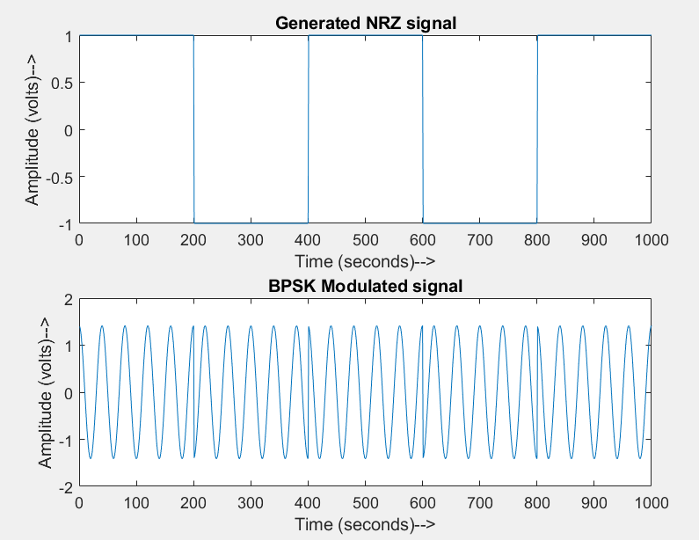
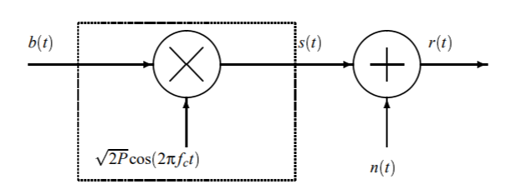
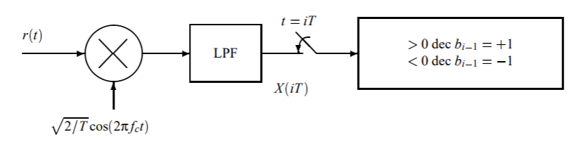
Theory
For input bits [1 0 1 0 1]
Binary Phase Shift Keying (BPSK) - is a type of digital modulation technique in which we send one bit per symbol i.e., ‘0’ or a ‘1’(one for logic high, zero for logic low). Hence, the bit rate and symbol rate are the same. We only have 360° of phase to work with, so the maximum difference between the logic-high and logic-low phases is 180°. This makes these two waveforms antipodal.
MODULATION
DEMODULATION

Slide 4
Algorithm
Step 1: Generating random sequence of 1024 BPSK symbols per frame. The generated symbols comprise of -1s and 1s since the bit stream consists only of 0s & 1s. Plot the original constellation diagram for the transmitted symbols assuming no noise.
Step 2: Create Gaussian noise with different noise power density values and observe the variations.
Step 3: Form received signals r = s+n with Eb/No in [0 : 14] dB in steps of 2dB.
Decision formula:
Mark as error if (r(k)>0 && s(k)==-1)||(r(k)<0 && s(k)==1)
Compute the bit error rate for each SNR value.
Step 4: Calculate analytical BER as BER_th=(1/2)*erfc(sqrt(SNR)). Verify BER plot (simulations) with the analytical computation of BER for BPSK.

Slide 5
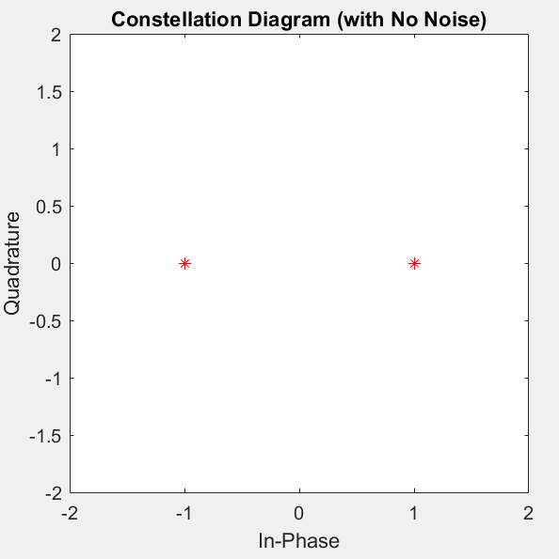
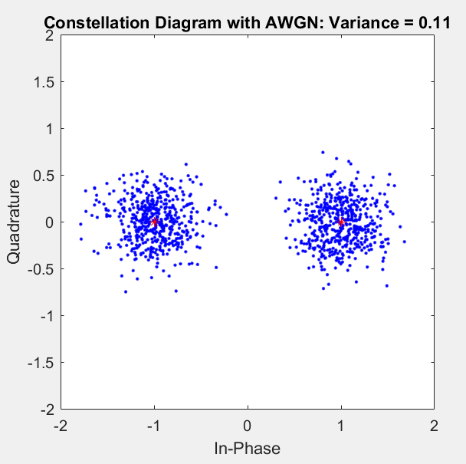
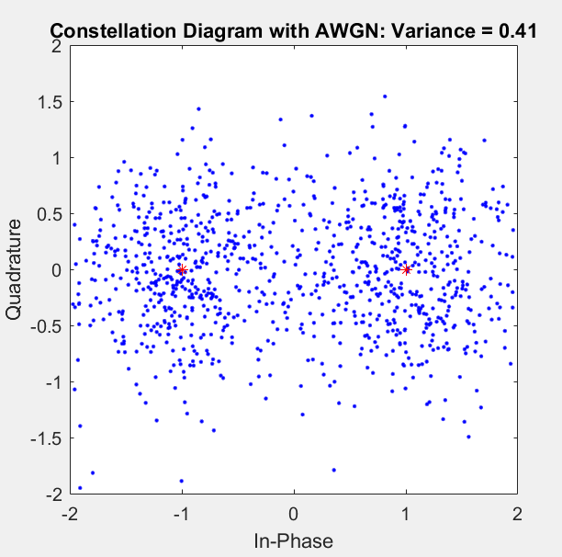
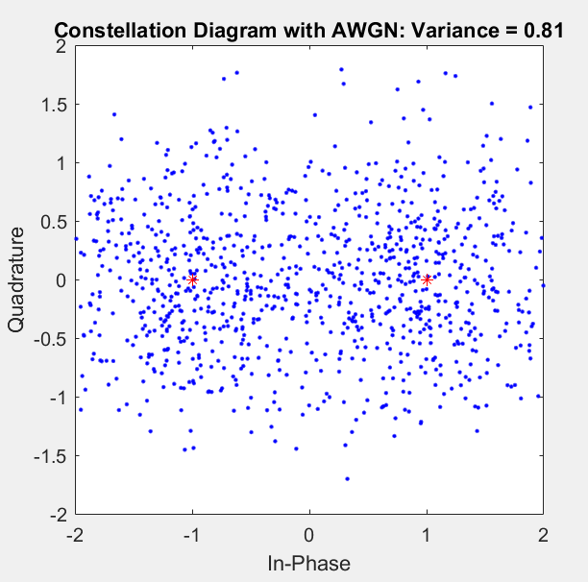
observations

Slide 6
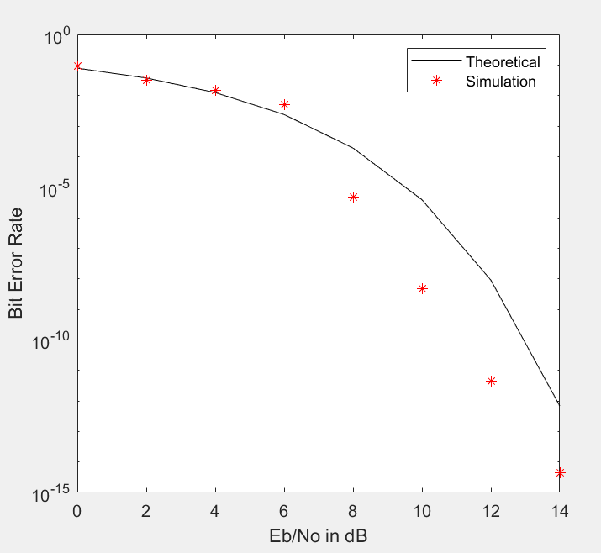
INFERENCE:
1. The phase changes by 180º when there is change in transmitted input bit (i.e, 0 to 1 or 1 to 0).
2. As variance of the noise increases, ie as SNR decreases, the constellation diagram becomes more populated with noisy signals.
3. As SNR increases, it can be seen that the variance of noise changes and the BER decreases, obtaining a waterfall graph.
RESULT:
The constellation diagram after adding AWGN was observed and the computation for BER is compared with its theoretical counterpart.
BER vs SNR: Simulated and theoretical curves

